Slide 1

UNIT THREE: ENERGY AND SOCIETY
Energy and Work
This lesson will introduce you to work.
You will also learn about the different forms of energy

Slide 2
Learning Goals
By the end of this lesson, you will be able to:
define energy
define work
list the two forms of energy
calculate when work is done on objects

Slide 3
Success Criteria
Can I:
state and explain the definition of energy
state and explain the definition of work
list the two forms of energy
identify types of energy in each form
calculate the work done on an object

Slide 4
Definition of WORK
Work is the transfer of energy from one form to another.
Work is a scalar quantity
The symbol for work is W
Work is measured in Joule’s, J
1 J = 1 N∙m = 1kg∙m²/s²
Work is done when a force acts over a distance

Slide 5
Definition of ENERGY
Energy is the ability to do work.
Energy is a scalar quantity
The symbol for energy is E
Energy is also measured in Joule’s, J

Slide 6
Common FORMS of ENERGY
Energy exists in many forms.
Kinetic Energy is the energy possessed by an object
due to its motion.
Potential Energy is energy stored in matter due to its
position or the arrangement of its parts

Slide 7
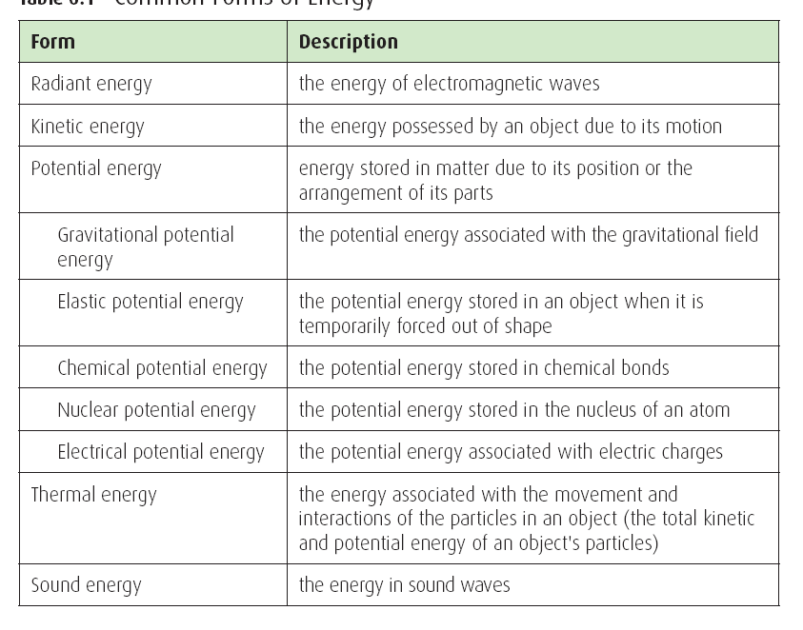

Slide 8
Calculating WORK
F = the force
Δd = the distance moved
θ = the angle between the force and the direction
of motion

Slide 9
Sample Problem
A mother pushes a stroller with a horizontal force of 123 N as the stroller moves 42.5 m. What is the work done by the mother on the stroller?
Sol’n:
F = 123 N [F]
Δd = 42.5 m
θ = 0º
W = ?
∴ the work done is 5230 J

Slide 10
Sample Problem
If the mother pushes a stroller with a force of 123 N [R45ºD] as the stroller moves 42.5 m. What is the work done now?
Sol’n:
F = 123 N [R45ºD]
Δd = 42.5
θ = 315º
W = ?
∴ the work done is 3.70 x 10³ J

Slide 11
When is work done?
Work is done only if
a force acts on the object
the object moves (changes position)
there is a part of the force in the dir of motion
Work can also be negative. This occurs if the angle
between the force and the dir of motion is 180º

Slide 12
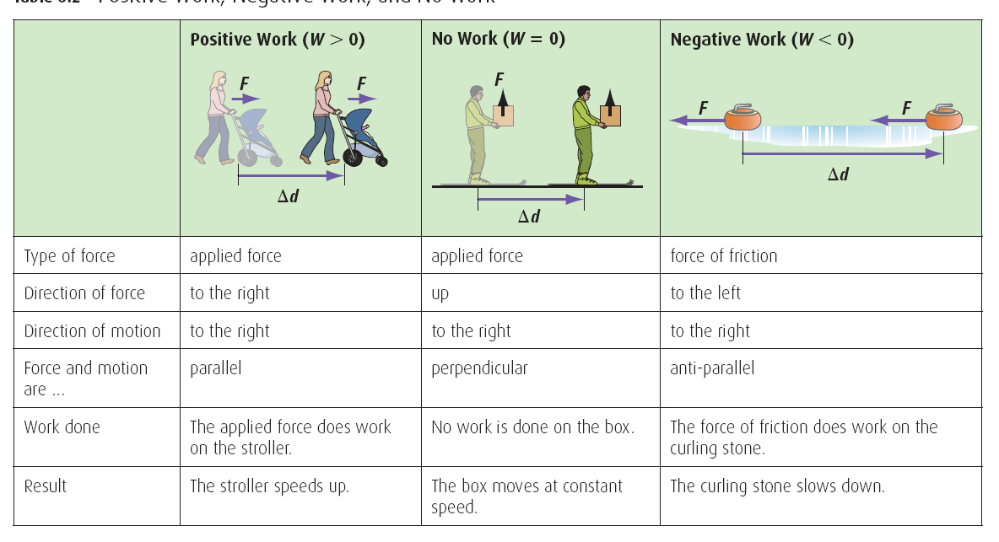

Slide 13
HOMEWORK
Read Section 5.1
Review Tutorial 1 – 4
Questions 1 pg 223
1 – 2 pg 225
1 pg 226
1 – 2 pg 227

